Slide 1
Lord of the flies
BSCS SECTION A2 (LAB)
Group Members:
1. Mukand Krishna (20k-0409)
2. Anas Ali (20k-0471)
3. Bahadur Khan (20k-1081)
4. Sumsam Ali (20k-1075)

Slide 2
To what extent do the boys in Lord of the Flies embody the English stereotype of savages
The English made judgments about people's wealth, age, attitude, and lifestyle based solely on their appearance, even before we consider their behavior. Golding, knowing this, dresses the boys in ways that will trigger a visceral response in his readers. In the beginning, when the boys are still in possession of their civilized veneer, they are dressed in school uniforms, clothes that make readers think of lessons, rules, and authority. Almost immediately, however, these symbols of order come under attack. The boys strip to swim or for the sheer anarchic fun of being naked. They allow their neatly trimmed hair and nails to grow unchecked. They forget hygiene. Their clothes, their teeth, and their bodies become dirty.
The signal fire itself comes to represent the boys’ grasp on the idea of civilization: as long as it burns, they retain some hope that they will be rescued and returned to society, but as they become increasingly obsessed with power and killing, they lose interest in the fire. The burned-out fire symbolizes the boys’ disconnection from the structures of society. Englishmen also considered that those people with no connection with the civilized and more dominant part of people were savage.

Slide 3
The difference is that civilization has many rules and savagery only one: might makes right. Repeatedly, Englishness is equated with civilization, with rational behavior and with rules. Even Jack, initially, espouses this view, stating the need for rules after the boys adopt a parliamentary structure for their meetings. "After all, we're not savages. We're English we've got to do the right things". Yet within hours of the making of the rules, Jack is breaking. According to Englishmen, the savagery was also an instinct of those who had no rules and lived for themselves.
Golding's answer, of course, is yes. We are savages, all of us, kept in check by the fragile safeguards of rules, customs, and the belief in something better than we are. Without these things, the boys revert to an older, darker way of life. The English men also made them follow the rules.

Slide 4
In what way(s) do they differ from the stereotype?
The Victorian perspective was that "savages" were inferior to industrialized peoples and that civilization must be imposed on them for their own good, whether they liked it or not. Western regarded unindustrialized culture as being composed of "noble savages.", but according to Golding the boys though they had no industrialized area were not savage they developed savagery with time
West differentiated people on basis on skin and origin. But Golding didn’t mention any of the boys skin though according to him savagery depended on appearance but his regard to this was not of the basis of racism.
Golding in the last chapters shows boys being indulge in killing one another and showing dominancy over each other. Golding considers this instinct as part of savagery while Britain which attained rule over many colonies considered this dominancy to be good and not a part of savagery. The people under dominancy should serve the dominant people

Slide 5
European followed Charles Darwin’s theory fittest creatures survived it’s hegemony seemed to be everywhere. In Golding's era it could be claimed that “the sun never set on the British Empire.", when Piggy suggests that they find a way to improve their chances of being rescued, the boys ignore him; only when the stronger and more charismatic Ralph suggests the same thing do they agree to make the signal fire.
The English were cruel as it can be noted that Boys of Golding's generation and even later read stories thick with adventurous conquest, threats of torture or execution by "savages," and the worshipful admiration and servitude of "good" people of color for the stalwart white heroes. Though the savages endured all the torture, the English men kept considering them savage and gentle people were those who enforced that cruelty i.e. The Englishmen. But according to Golding cruelty was an instinct of savages.

Slide 6
What does it mean that Golding merges the savage and the civilized in the very same boys?
Golding’s assumption : constraints of morality and society are learned, they are not primal instincts.
The human tendency to obey rules and follow orders is imposed by a system of control which is a not a fundamental part of human nature.
In the beginning of story, the boys are in possession of their civilized veneer.
They are dressed in school uniforms that make readers think of lessons, rules, and authority. However, these symbols of order come under attack.
The question arises "Are we savages or what?“
According to Golding the answer is yes. Why?

Slide 7
Golding shows that humans primal instincts make them behave savagely.
Instincts, including denial, revenge, tribal loyalty, and greed now threaten our very existence.
Golding depicts the boys' transformation into savages.
For example, their refusal to follow Ralph's orders, Jack undermines his authority.
To conclude, it can be said that human beings are inherently savage or wicked who embrace their primitive instincts if left to their own devices. We are also civilized when we abide by the rules and regulations which are imposed by government of any particular region.

Slide 8
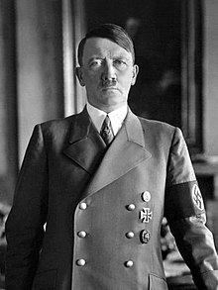
WHAT IS BEING CIIVLISED?
The common perspective
Set of standards and rules that a society or culture expects you to adopt when you participate in their activities .
Some limitation you are supposed to show in a social gathering.
Two aspects these days: Clothing, communication style, education.
Controlling emotion and using logic and reasoning to deal situations in practical life.
LOOKS CIVILISED YEAH?
BARBARIC LEADER; Killed over 15 million people in WW2

Slide 9
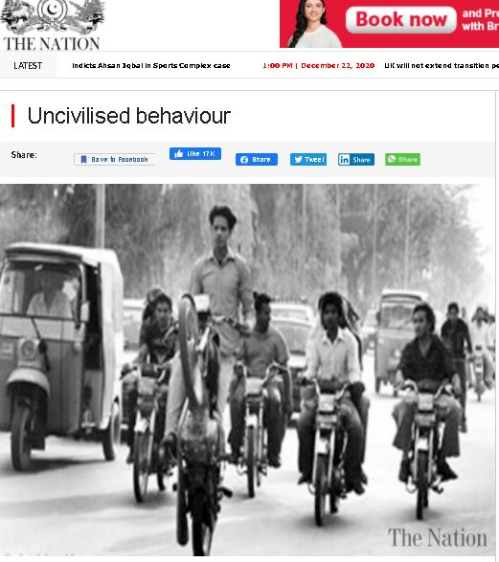

WHAT IS BEING UNCIIVLISED?
Possessing wild or barbaric nature
Immoral vs Amoral
Not abiding by state’s law
Were we uncivilized when we were animals?
Savages back then were amoral; uncivilized in our world view
WORLD VIEW
CHINA DECLARES PEOPLE NOT WEARING MASKS AS UNCIVILISED!
Reference: The Nation
Reference: Times of India

Slide 10
THE CONCLUSION
Respects others irrespective of religion, caste, color or creed
Maintains peace; i.e. To not hurt each other in terms of health and societal crimes.
Basic morals of what is right and what is wrong may be innately present in us since the first modern human.
Just like humans have evolved, the word civilized has evolved too.

